Slide 1

Introduction to Pandas
A Library that is Used for Data Manipulation and Analysis Tool
Using Powerful Data Structures

Slide 2
Pandas First Steps: install and import
Pandas is an easy package to install. Open up your terminal program (shell or cmd) and install it using either of the following commands:
For jupyter notebook users, you can run this cell:
The ! at the beginning runs cells as if they were in a terminal.
To import pandas we usually import it with a shorter name since it's used so much:
$ conda install pandas
OR
$ pip install pandas
!pip install pandas
import pandas as pd
Installation: https://pandas.pydata.org/pandas-docs/stable/getting_started/install.html

Slide 3
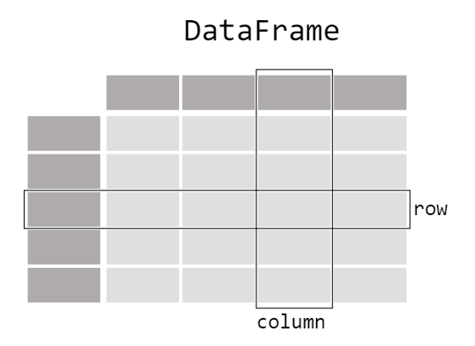
pandas: Data Table Representation

Slide 4
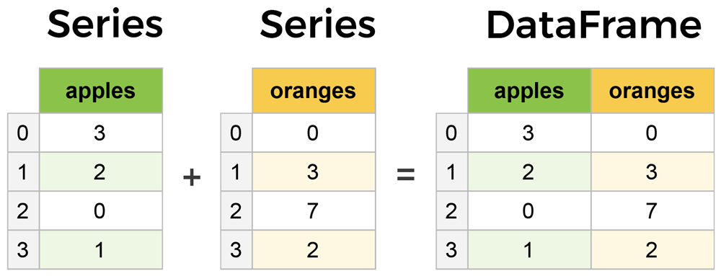
Core components of pandas: Series & DataFrames
The primary two components of pandas are the Series and DataFrame.
Series is essentially a column, and
DataFrame is a multi-dimensional table made up of a collection of Series.
DataFrames and Series are quite similar in that many operations that you can do with one you can do with the other, such as filling in null values and calculating the mean.
A Data frame is a two-dimensional data structure, i.e., data is aligned in a tabular fashion in rows and columns.
columns
Features of DataFrame
Potentially columns are of different types
Size – Mutable
Labeled axes (rows and columns)
Can Perform Arithmetic operations on rows and columns
rows

Slide 5
Types of Data Structure in Pandas
Data Structure | Dimensions | Description
Series | 1 | 1D labeled homogeneous array with immutable size
Data Frames | 2 | General 2D labeled, size mutable tabular structure with potentially heterogeneously typed columns.
Panel | 3 | General 3D labeled, size mutable array.
Series & DataFrame
Series is a one-dimensional array (1D Array) like structure with homogeneous data.
DataFrame is a two-dimensional array (2D Array) with heterogeneous data.
Panel
Panel is a three-dimensional data structure (3D Array) with heterogeneous data.
It is hard to represent the panel in graphical representation.
But a panel can be illustrated as a container of DataFrame

Slide 6
pandas.DataFrame
pandas.DataFrame(data, index , columns , dtype , copy )
data: data takes various forms like ndarray, series, map, lists, dict, constants and also another DataFrame.
index: For the row labels, that are to be used for the resulting frame, Optional, Default is np.arrange(n)if no index is passed.
columns: For column labels, the optional default syntax is - np.arrange(n). This is only true if no index is passed.
dtype: Data type of each column.
copy: This command (or whatever it is) is used for copying of data, if the default is False.
Create DataFrame
A pandas DataFrame can be created using various inputs like −
Lists
dict
Series
Numpy ndarrays
Another DataFrame

Slide 7

Creating a DataFrame from scratch

Slide 8
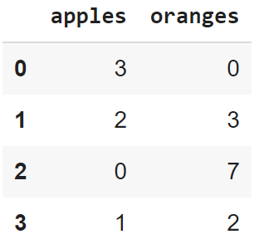
Creating a DataFrame from scratch
There are many ways to create a DataFrame from scratch, but a great option is to just use a simple dict. But first you must import pandas.
Let's say we have a fruit stand that sells apples and oranges. We want to have a column for each fruit and a row for each customer purchase. To organize this as a dictionary for pandas we could do something like:
And then pass it to the pandas DataFrame constructor:
import pandas as pd
data = { 'apples':[3, 2, 0, 1] , 'oranges':[0, 3, 7, 2] }
df = pd.DataFrame(data)

Slide 9
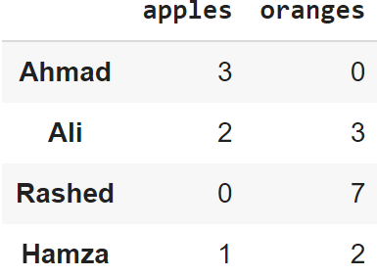
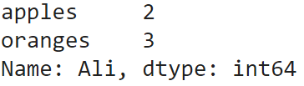
How did that work?
Each (key, value) item in data corresponds to a column in the resulting DataFrame.
The Index of this DataFrame was given to us on creation as the numbers 0-3, but we could also create our own when we initialize the DataFrame.
E.g. if you want to have customer names as the index:
df = pd.DataFrame(data, index=['Ahmad', 'Ali', 'Rashed', 'Hamza'])
So now we could locate a customer's order by using their names:
df.loc['Ali']

Slide 10
pandas.DataFrame.from_dict
pandas.DataFrame.from_dict(data, orient='columns', dtype=None, columns=None)
data : dict
Of the form {field:array-like} or {field:dict}.
orient : {‘columns’, ‘index’}, default ‘columns’
The “orientation” of the data.
If the keys of the passed dict should be the columns of the resulting DataFrame, pass ‘columns’ (default).
Otherwise if the keys should be rows, pass ‘index’.
dtype : dtype, default None
Data type to force, otherwise infer.
columns : list, default None
Column labels to use when orient='index'. Raises a ValueError if used with orient='columns'.
https://pandas.pydata.org/pandas-docs/version/0.23/generated/pandas.DataFrame.from_dict.html

Slide 11
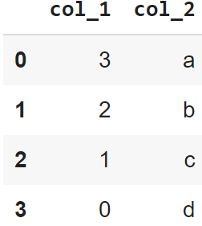
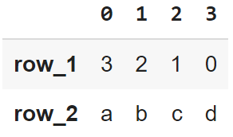
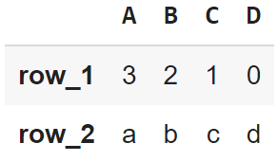
pandas’ orient keyword
data = {'col_1':[3, 2, 1, 0], 'col_2':['a','b','c','d']}
pd.DataFrame.from_dict(data)
data = {'row_1':[3, 2, 1, 0], 'row_2':['a','b','c','d']}
pd.DataFrame.from_dict(data,
orient='index')
data = {'row_1':[3, 2, 1, 0], 'row_2':['a','b','c','d']}
pd.DataFrame.from_dict(data, orient = 'index', columns = ['A','B','C','D'])

Slide 12
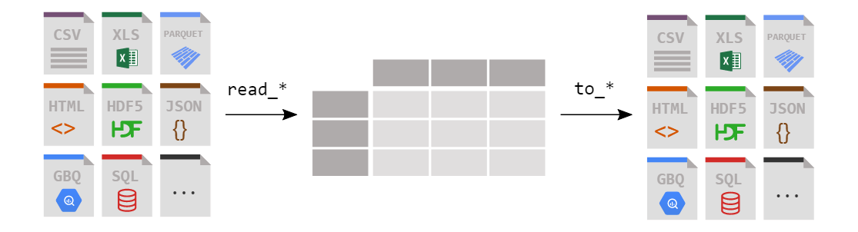
Loading a DataFrame from files

Slide 13
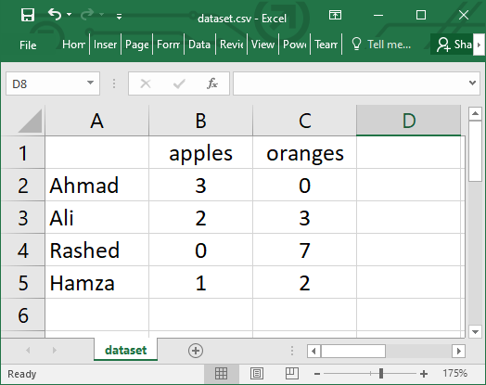
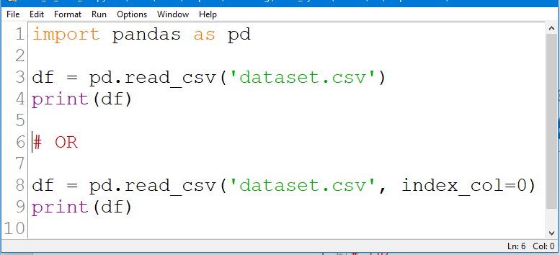
Reading data from a CSV file

Slide 14
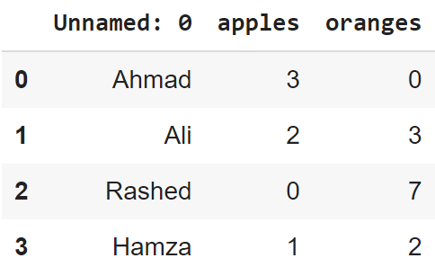
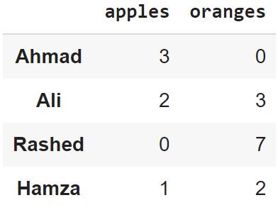
Reading data from CSVs
With CSV files, all you need is a single line to load in the data:
df = pd.read_csv('dataset.csv')
CSVs don't have indexes like our DataFrames, so all we need to do is just designate the index_col when reading:
df = pd.read_csv('dataset.csv', index_col=0)
Note: here we're setting the index to be column zero.

Slide 15
Reading data from JSON
If you have a JSON file — which is essentially a stored Python dict — pandas can read this just as easily:
df = pd.read_json('dataset.json')
Notice this time our index came with us correctly since using JSON allowed indexes to work through nesting.
Pandas will try to figure out how to create a DataFrame by analyzing structure of your JSON, and sometimes it doesn't get it right.
Often you'll need to set the orient keyword argument depending on the structure

Slide 16
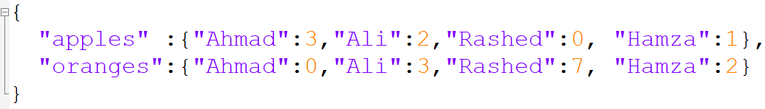
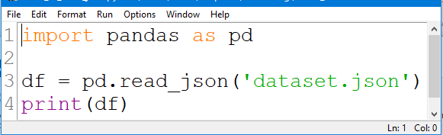
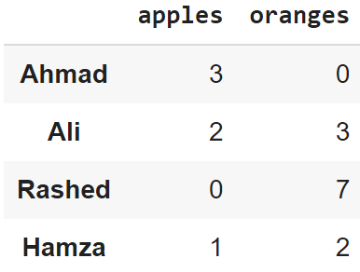
Example #1:Reading data from JSON

Slide 17
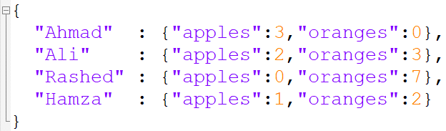
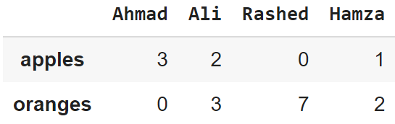
Example #2: Reading data from JSON

Slide 18
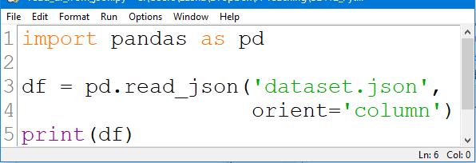
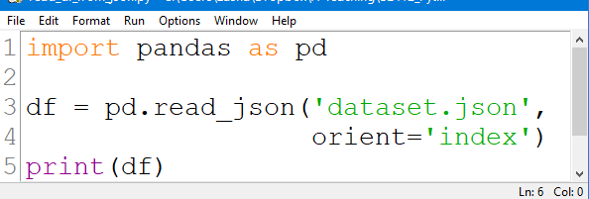
Example #3: Reading data from JSON

Slide 19
Converting back to a CSV or JSON
So after extensive work on cleaning your data, you’re now ready to save it as a file of your choice. Similar to the ways we read in data, pandas provides intuitive commands to save it:
When we save JSON and CSV files, all we have to input into those functions is our desired filename with the appropriate file extension.
df.to_csv('new_dataset.csv')
df.to_json('new_dataset.json')
df.to_sql('new_dataset', con)
Reference: https://pandas.pydata.org/pandas-docs/stable/reference/api/pandas.DataFrame.to_json.html

Slide 20
Most important Pandas DataFrame operations
DataFrames possess hundreds of methods and other operations that are crucial to any analysis.
As a beginner, you should know the operations that:
that perform simple transformations of your data and those
that provide fundamental statistical analysis on your data.

Slide 21
Loading dataset
We're loading this dataset from a CSV and designating the movie titles to be our index.
movies_df = pd.read_csv("movies.csv", index_col="title")
https://grouplens.org/datasets/movielens/

Slide 22
Viewing your data
The first thing to do when opening a new dataset is print out a few rows to keep as a visual reference. We accomplish this with .head():
.head() outputs the first five rows of your DataFrame by default, but we could also pass a number as well: movies_df.head(10) would output the top ten rows, for example.
To see the last five rows use .tail() that also accepts a number, and in this case we printing the bottom two rows.:
movies_df.head()
movies_df.tail(2)

Slide 23
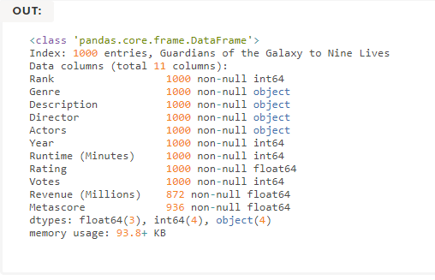

Getting info about your data
.info() should be one of the very first commands you run after loading your data
.info() provides the essential details about your dataset, such as the number of rows and columns, the number of non-null values, what type of data is in each column, and how much memory your DataFrame is using.
movies_df.info()
movies_df.shape

Slide 24


Handling duplicates
This dataset does not have duplicate rows, but it is always important to verify you aren't aggregating duplicate rows.
To demonstrate, let's simply just double up our movies DataFrame by appending it to itself:
Using append() will return a copy without affecting the original DataFrame. We are capturing this copy in temp so we aren't working with the real data.
Notice call .shape quickly proves our DataFrame rows have doubled.
temp_df = movies_df.append(movies_df)
temp_df.shape
Now we can try dropping duplicates:
temp_df = temp_df.drop_duplicates()
temp_df.shape

Slide 25
Handling duplicates
Just like append(), the drop_duplicates() method will also return a copy of your DataFrame, but this time with duplicates removed. Calling .shape confirms we're back to the 1000 rows of our original dataset.
It's a little verbose to keep assigning DataFrames to the same variable like in this example. For this reason, pandas has the inplace keyword argument on many of its methods. Using inplace=True will modify the DataFrame object in place:
Another important argument for drop_duplicates() is keep, which has three possible options:
first: (default) Drop duplicates except for the first occurrence.
last: Drop duplicates except for the last occurrence.
False: Drop all duplicates.
temp_df.drop_duplicates(inplace=True)
https://www.learndatasci.com/tutorials/python-pandas-tutorial-complete-introduction-for-beginners/

Slide 26
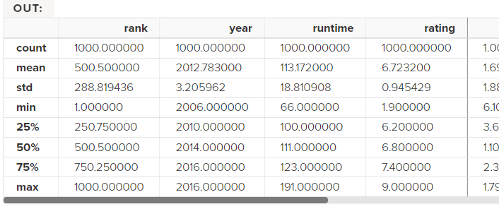
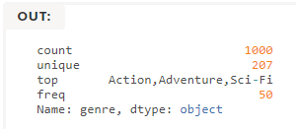
Understanding your variables
Using .describe() on an entire DataFrame we can get a summary of the distribution of continuous variables:
.describe() can also be used on a categorical variable to get the count of rows, unique count of categories, top category, and freq of top category:
This tells us that the genre column has 207 unique values, the top value is Action/Adventure/Sci-Fi, which shows up 50 times (freq).
movies_df.describe()
movies_df['genre'].describe()

Slide 27


More Examples
import pandas as pd
data = [1,2,3,10,20,30]
df = pd.DataFrame(data)
print(df)
import pandas as pd
data = {'Name' : ['AA', 'BB'], 'Age': [30,45]}
df = pd.DataFrame(data)
print(df)

Slide 28
More Examples
import pandas as pd
data = [{'a': 1, 'b': 2},{'a': 5, 'b': 10, 'c': 20}]
df = pd.DataFrame(data)
print(df)
a b c
0 1 2 NaN
1 5 10 20.0
import pandas as pd
data = [{'a': 1, 'b': 2},{'a': 5, 'b': 10, 'c': 20}]
df = pd.DataFrame(data, index=['first', 'second'])
print(df)
a b c
first 1 2 NaN
second 5 10 20.0

Slide 29
More Examples
E.g. This shows how to create a DataFrame with a list of dictionaries, row indices, and column indices.
import pandas as pd
data = [{'a': 1, 'b': 2},{'a': 5, 'b': 10, 'c': 20}]
#With two column indices, values same as dictionary keys
df1 = pd.DataFrame(data,index=['first','second'],columns=['a','b'])
#With two column indices with one index with other name
df2 = pd.DataFrame(data,index=['first','second'],columns=['a','b1'])
print(df1)
print('...........')
print(df2)
a b
first 1 2
second 5 10
...........
a b1
first 1 NaN
second 5 NaN

Slide 30
More Examples: Create a DataFrame from Dict of Series
import pandas as pd
d = {'one' : pd.Series([1, 2, 3] , index=['a', 'b', 'c']),
'two' : pd.Series([1,2, 3, 4], index=['a', 'b', 'c', 'd'])
}
df = pd.DataFrame(d)
print(df)
one two
a 1.0 1
b 2.0 2
c 3.0 3
d NaN 4

Slide 31
More Examples: Column Addition
import pandas as pd
d = {'one':pd.Series([1,2,3], index=['a','b','c']),
'two':pd.Series([1,2,3,4], index=['a','b','c','d'])
}
df = pd.DataFrame(d)
# Adding a new column to an existing DataFrame object
# with column label by passing new series
print("Adding a new column by passing as Series:")
df['three'] = pd.Series([10,20,30],index=['a','b','c'])
print(df)
print("Adding a column using an existing columns in DataFrame:")
df['four'] = df['one']+df['three']
print(df)
Adding a column using Series:
one two three
a 1.0 1 10.0
b 2.0 2 20.0
c 3.0 3 30.0
d NaN 4 NaN
Adding a column using columns:
one two three four
a 1.0 1 10.0 11.0
b 2.0 2 20.0 22.0
c 3.0 3 30.0 33.0
d NaN 4 NaN NaN

Slide 32
More Examples: Column Deletion
# Using the previous DataFrame, we will delete a column
# using del function
import pandas as pd
d = {'one' : pd.Series([1, 2, 3], index=['a', 'b', 'c']),
'two' : pd.Series([1, 2, 3, 4], index=['a', 'b', 'c', 'd']),
'three' : pd.Series([10,20,30], index=['a','b','c'])
}
df = pd.DataFrame(d)
print ("Our dataframe is:")
print(df)
# using del function
print("Deleting the first column using DEL function:")
del df['one']
print(df)
# using pop function
print("Deleting another column using POP function:")
df.pop('two')
print(df)
Our dataframe is:
one two three
a 1.0 1 10.0
b 2.0 2 20.0
c 3.0 3 30.0
d NaN 4 NaN
Deleting the first column:
two three
a 1 10.0
b 2 20.0
c 3 30.0
d 4 NaN
Deleting another column:
a 10.0
b 20.0
c 30.0
d NaN

Slide 33
More Examples: Slicing in DataFrames
import pandas as pd
d = {'one' : pd.Series([1, 2, 3], index=['a', 'b', 'c']),
'two' : pd.Series([1, 2, 3, 4], index=['a', 'b', 'c','d'])
}
df = pd.DataFrame(d)
print(df[2:4])
one two
c 3.0 3
d NaN 4

Slide 34
More Examples: Addition of rows
import pandas as pd
d = {'one' : pd.Series([1, 2, 3], index=['a', 'b', 'c']),
'two' : pd.Series([1, 2, 3, 4], index=['a', 'b', 'c','d'])
}
df = pd.DataFrame(d)
print(df)
df2 = pd.DataFrame([[5,6], [7,8]], columns = ['a', 'b'])
df = df.append(df2 )
print(df)
one two
a 1.0 1
b 2.0 2
c 3.0 3
d NaN 4
one two a b
a 1.0 1.0 NaN NaN
b 2.0 2.0 NaN NaN
c 3.0 3.0 NaN NaN
d NaN 4.0 NaN NaN
0 NaN NaN 5.0 6.0
1 NaN NaN 7.0 8.0

Slide 35
More Examples: Deletion of rows
import pandas as pd
d = {'one':pd.Series([1, 2, 3], index=['a','b','c']),
'two':pd.Series([1, 2, 3, 4], index=['a','b','c','d'])
}
df = pd.DataFrame(d)
print(df)
df2 = pd.DataFrame([[5,6], [7,8]], columns = ['a', 'b'])
df = df.append(df2 )
print(df)
df = df.drop(0)
print(df)
one two
a 1.0 1
b 2.0 2
c 3.0 3
d NaN 4
one two a b
a 1.0 1.0 NaN NaN
b 2.0 2.0 NaN NaN
c 3.0 3.0 NaN NaN
d NaN 4.0 NaN NaN
0 NaN NaN 5.0 6.0
NaN NaN 7.0 8.0
one two a b
a 1.0 1.0 NaN NaN
b 2.0 2.0 NaN NaN
c 3.0 3.0 NaN NaN
d NaN 4.0 NaN NaN
1 NaN NaN 7.0 8.0

Slide 36
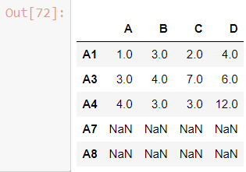
More Examples: Reindexing
Pandas dataframe.reindex_like() function return an object with matching indices to myself.
Any non-matching indexes are filled with NaN values.
import pandas as pd
# Creating the first dataframe
df1 = pd.DataFrame({"A":[1, 5, 3, 4, 2],
"B":[3, 2, 4, 3, 4],
"C":[2, 2, 7, 3, 4],
"D":[4, 3, 6, 12, 7]},
index =["A1", "A2", "A3", "A4", "A5"])
# Creating the second dataframe
df2 = pd.DataFrame({"A":[10, 11, 7, 8, 5],
"B":[21, 5, 32, 4, 6],
"C":[11, 21, 23, 7, 9],
"D":[1, 5, 3, 8, 6]},
index =["A1", "A3", "A4", "A7", "A8"])
# Print the first dataframe
print(df1)
print(df2)
# find matching indexes
df1.reindex_like(df2)

Slide 37
More Examples: Concatenating Objects (Data Frames)
import pandas as pd
df1 = pd.DataFrame({'Name':['A','B'], 'SSN':[10,20], 'marks':[90, 95] })
df2 = pd.DataFrame({'Name':['B','C'], 'SSN':[25,30], 'marks':[80, 97] })
df3 = pd.concat([df1, df2])
df3

Slide 38
Handling categorical data
There are many data that are repetitive for example gender , country , and codes are always repetitive .
Categorical variables can take on only a limited
The categorical data type is useful in the following cases −
A string variable consisting of only a few different values. Converting such a string variable to a categorical variable will save some memory.
The lexical order of a variable is not the same as the logical order (“one”, “two”, “three”).
By converting to a categorical and specifying an order on the categories, sorting and min/max will use the logical order instead of the lexical order.
As a signal to other python libraries that this column should be treated as a categorical variable (e.g. to use suitable statistical methods or plot types).

Slide 39
Examples
import pandas as pd
cat = pd.Categorical(['a', 'b', 'c', 'a', 'b', 'c'])
print(cat)
import pandas as pd
import numpy as np
cat = pd.Categorical(["a", "c", "c", np.nan], categories=["b", "a", "c"])
df = pd.DataFrame({"cat": cat, "s":["a", "c", "c", np.nan]})
print(df.describe())
print(df["cat"].describe())

Slide 40
Reading data from a SQL database
f you’re working with data from a SQL database you need to first establish a connection using an appropriate Python library, then pass a query to pandas. Here we'll use SQLite to demonstrate.
First, we need pysqlite3 installed, so run this command in your terminal:
pip install pysqlite3
Or run this cell if you're in a notebook: !pip install pysqlite3
sqlite3 is used to create a connection to a database which we can then use to generate a DataFrame through a SELECT query.
So first we'll make a connection to a SQLite database file:
In this SQLite database we have a table called purchases, and our index is in a column called "index".
By passing a SELECT query and our con, we can read from the purchases table:
import sqlite3
con = sqlite3.connect("database.db")
df = pd.read_sql_query("SELECT * FROM purchases", con)

Slide 41
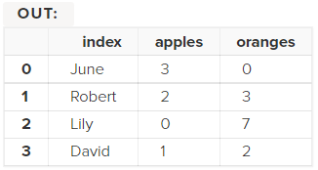
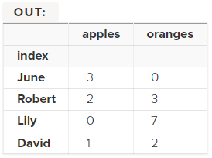
Reading data from a SQL database
In this SQLite database we have a table called purchases, and our index is in a column called "index".
By passing a SELECT query and our con, we can read from the purchases table:
Just like with CSVs, we could pass index_col='index', but we can also set an index after-the-fact:
In fact, we could use set_index() on any DataFrame using any column at any time. Indexing Series and DataFrames is a very common task, and the different ways of doing it is worth remembering.
df = pd.read_sql_query("SELECT * FROM purchases", con)
df = df.set_index('index')

Slide 42
References
pandas documentation
https://pandas.pydata.org/pandas-docs/stable/index.html
pandas: Input/output
https://pandas.pydata.org/pandas-docs/stable/reference/io.html
pandas: DataFrame
https://pandas.pydata.org/pandas-docs/stable/reference/frame.html
pandas: Series
https://pandas.pydata.org/pandas-docs/stable/reference/series.html
pandas: Plotting
https://pandas.pydata.org/pandas-docs/stable/reference/plotting.html

Slide 43
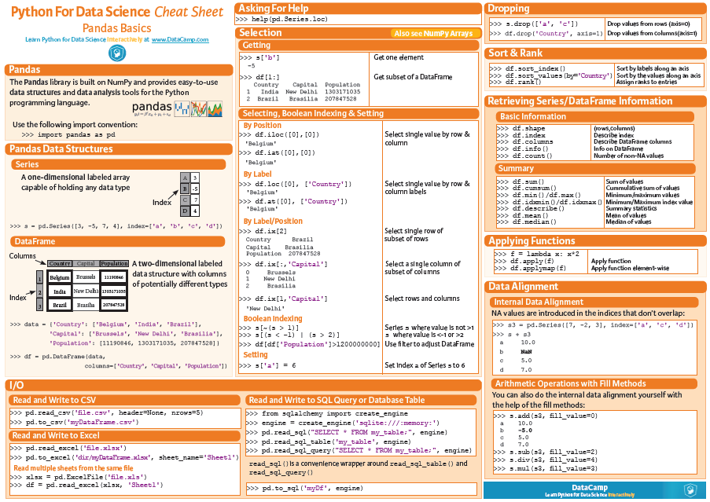

Slide 44
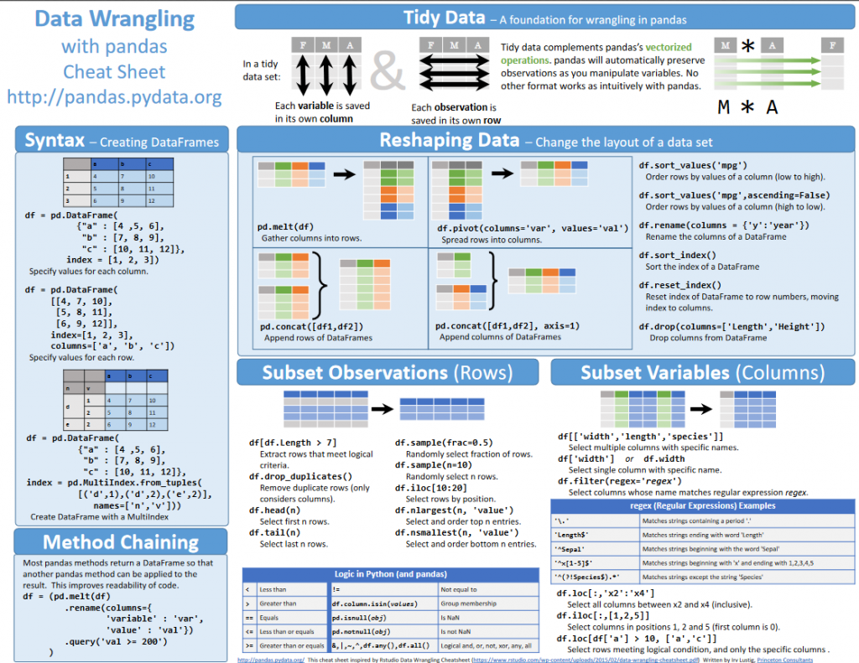

Slide 45
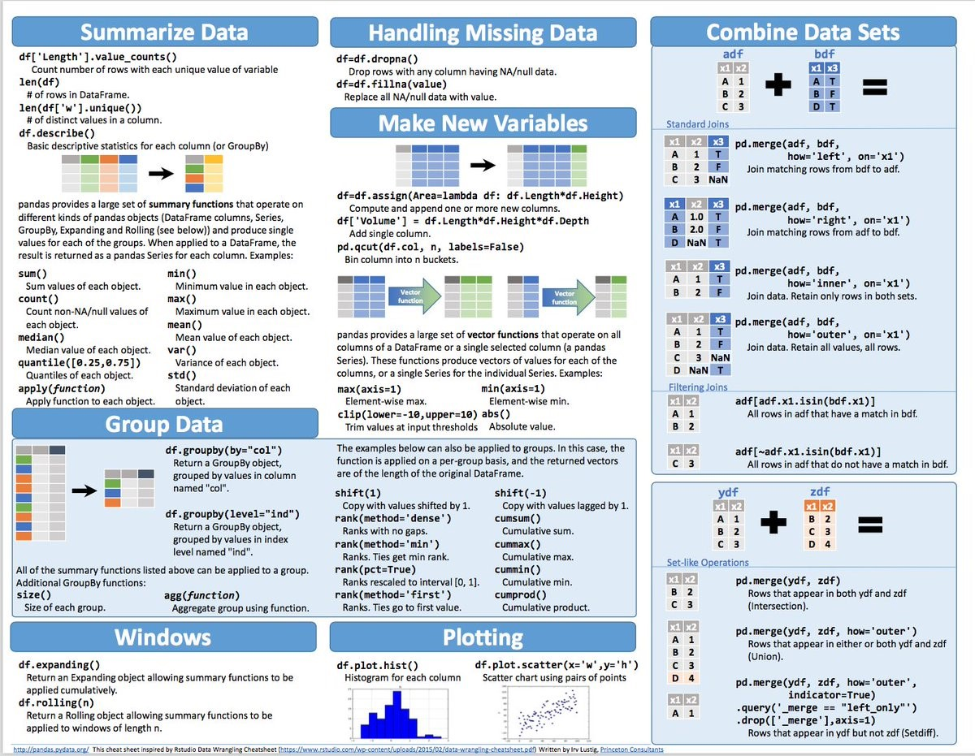

Slide 46
